Slide 1
Object Oriented Programming (Introduction to Programming) Jooyoung Lee
Lecture 6: Invariants and Logic

Slide 2
Reminder: contracts
Associated with an individual feature:
Preconditions
Postconditions
Associated with a class:
Class invariant

Slide 3
Contracts
Assertions
remove_all_segments
-- Remove all stations except the south end.
ensure
only_one_left: count = 1
both_ends_same: south_end = north_end
Assertions
extend (s : STATION )
-- Add s at end of line.
ensure
new_station_added: i_th (count ) = s
added_at_north: north_end = s
one_more: count = old count + 1

Slide 4
Contracts
deposit (v : INTEGER)
-- Add v to account.
require
positive: v > 0
do
…
ensure
added: balance = old balance + v
end
Assertion

Slide 5
Class invariants
The invariant expresses consistency requirements between queries of a class
invariant
south_is_first: south_end = i_th (1)
north_is_last: north_end = i_th (count )

Slide 6
Applications of contracts
Getting the software right
Documenting it; in particular, documenting APIs
Testing & debugging

Slide 7
Contracts outside of Eiffel
Java: Java Modeling Language (JML), iContract, etc.
C#: Spec# (Microsoft Research extension)
UML: Object Constraint Language
Python: decorators, PyContracts, etc.
C++: Nana
etc.

Slide 8
Logic
Programming is reasoning.
Logic is the science of reasoning.
We use logic in everyday life:
“Socrates is human. All humans are mortal. Therefore Socrates must be mortal.”

Slide 9
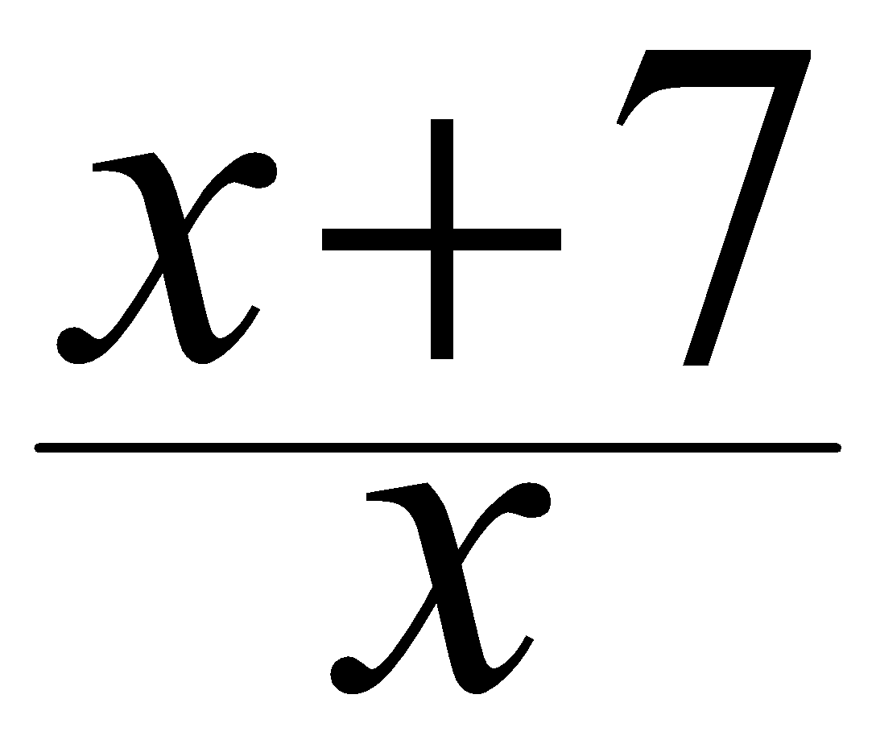
Reasoning and programming
Logic is the basis of
Mathematics: proofs are only valid if they follow the rules of logic.
Software development:
Conditions in contracts: “x must not be zero, so that we can calculate .”
Conditions in program actions: “If i is positive, then execute this instruction” (to be introduced in a later lecture)

Slide 10
Boolean expressions
A condition is expressed as a boolean expression.
It consists of
Boolean variables (identifiers denoting boolean values)
Boolean operators (not, or, and, =, implies)
and represents possible
Boolean values (truth values, either True or False)

Slide 11
Examples
Examples of boolean expressions (with rain_today and cuckoo_sang_last_night as boolean variables):
rain_today
(a boolean variable is a boolean expression)
not rain_today
(not cuckoo_sang_last_night) implies rain_today
(Parentheses group sub-expressions)

Slide 12
Negation (not)
a | not a
True | False
False | True
For any boolean expression e and any values of variables:
Exactly one of e and not e has value True
Exactly one of e and not e has value False
One of e and not e has value True (Principle of the Excluded Middle)
Not both of e and not e have value True (Principle of Non-Contradiction)

Slide 13
Disjunction (or)
a | b | a or b
True | True | True
True | False | True
False | True | True
False | False | False
or operator is non-exclusive
or operator is commutative
Disjunction principle:
An or disjunction has value True except if both operands have value False

Slide 14
Conjunction (and)
a | b | a and b
True | True | True
True | False | False
False | True | False
False | False | False
and operator is commutative.
Duality of and and or: properties of either operator yield properties of other (negating + swapping True and False)
Conjunction principle:
An and conjunction has value False except if both operands have value True

Slide 15
Complex expressions
Build more complex boolean expressions by using the boolean operators
Example:
a and (b and (not c))

Slide 16
Truth assignment and truth table
Truth assignment for a set of variables: particular choice of values (True or False), for every variable
A truth assignment satisfies an expression if the value for the expression is True
A truth table for an expression with n variables has
n + 1 columns
2^{n} rows

Slide 17
Combined truth table for basic operators
a | b | not a | a or b | a and b
True | True | False | True | True
True | False |  | True | False
False | True | True | True | False
False | False |  | False | False

Slide 18
Tautologies
Tautology: a boolean expression that has value True for every possible truth assignment
Examples:
a or (not a)
not (a and (not a))
(a and b) or ((not a) or (not b))
How to prove a statement is tautology?
Ex. [(not P) or (P or Q)] implies Q

Slide 19
Contradictions
Contradiction: a boolean expression that has value False for every possible truth assignment
Examples:
a and (not a)
Satisfiable: for at least one truth assignment the expression yields True
Any tautology is satisfiable
No contradiction is satisfiable.

Slide 20
Equivalence (=)
a | b | a = b
True | True | True
True | False | False
False | True | False
False | False | True
= operator is commutative (a = b has same value as b = a)
= operator is reflexive (a = a is a tautology for any a)
Substitution:
For any expressions u, v and e, if u = v is a tautology and e’ is the expression obtained from e by replacing every occurrence of u by v, then e = e’ is a tautology

Slide 21
De Morgan’s laws
De Morgan’s Laws: Tautologies
(not (a or b)) = ((not a) and (not b))
(not (a and b)) = ((not a) or (not b))
More tautologies (distributivity):
(a and (b or c)) = ((a and b) or (a and c))
(a or (b and c)) = ((a or b) and (a or c))

Slide 22
Syntax convention: binding of operators
Order of binding (starting with tightest binding ): not, and, or, implies (to be introduced), =.
and and or are associative:
a and (b and c) = (a and b) and c
a or (b or c) = (a or b) or c
Style rules:
When writing a boolean expression, drop the parentheses:
Around the expressions of each side of “=“if whole expression is an equivalence.
Around successive elementary terms if they are separated by the same associative operators.

Slide 23
Implication (implies)
a | b | a implies b
True | True | True
True | False | False
False | True | True
False | False | True
a implies b, for any a and b, is the value of (not a) or b
In a implies b: a is antecedent, b consequent
Implication principle:
An implication has value True except if its antecedent has value True and its consequent has value False
In particular, always True if antecedent is False

Slide 24
Implication in ordinary language
implies in ordinary language often means causation, as in “if … then …”
“If the weather stays like this, skiing will be great this week-end”
“If you put this stuff in your hand luggage, they won’t let you through.”

Slide 25
Misunderstanding implication
Whenever a is False, a implies b is True, regardless of b :
“If today is Monday, 2+2=5.”
“If 2+2=5, today is Wednesday.”
Both of the above implications are True
Cases in which a is False tell us nothing about the truth of the consequent

Slide 26
Reversing implications (1)
It is not generally true that
a implies b = (not a) implies (not b)
Example (wrong!):
“All the people in Zurich who live near the lake are rich. I do not live near the lake, so I am not rich.”
live_near_lake implies rich [1]
(not live_near_lake ) implies (not rich ) [2]

Slide 27
Reversing implications (2)
Correct:
a implies b = (not b) implies (not a)
Example:
“All the people who live near the lake are rich. She is not rich, so she can’t be living in Küsnacht”
live_near_lake implies rich =
(not rich) implies (not live_near_lake )

Slide 28
Semistrict boolean operators (1)
Example boolean-valued expression (x is an integer):
False for x < 0
Undefined for x = 0
x
+
7
>
1
x

Slide 29
Semistrict boolean operators (2)
BUT:
Division by zero: x must not be 0.
(x /= 0) and (((x + 7) / x) > 1)
False for x < 0
False for x = 0

Slide 30
Semistrict boolean operators (3)
BUT:
Program would crash during evaluation of division
We need a non-commutative version of and (and or): Semistrict boolean operators
Notes:
This way of evaluating expressions is also known as “short-circuit evaluation” (e.g., && and || in Java, C and C++)

Slide 31
Semistrict operators (and then, or else)
a and then b: has same value as a and b if a and b are defined, and has False whenever a has value False
a or else b: has same value as a or b if a and b are defined, and has True whenever a has value True
(x /= 0) and then (((x + 7) / x) > 1)
Semistrict operators allow us to define an order of expression evaluation (left to right).
Important for programming when undefined objects may cause program crashes
Notes:
An operator is “strict” (as in “my mum is strict about having everyone at the table before any of us starts eating”) if it insists, to produce its result, on having all operands values available (even those whose value may be not needed).
An operator is “semistrict” on an operand if it may, in some cases, yield a result even when that operand does not have a defined value.
“and then” and “or else” are semistrict because they are strict on their first operand and non-strict on the second.

Slide 32
Ordinary vs. Semistrict boolean operators
Use
Ordinary boolean operators (and and or) if you can guarantee that both operands are defined
and then if a condition only makes sense when another is true
or else if a condition only makes sense when another is false
Examples:
“If you are not single, then your spouse must sign the contract”
is_single or else spouse_must_sign
Is the n-th station of line l an exchange?
((n >= 1) and (n <= count)) and then l.i_th(n).is_exchange

Slide 33
Semistrict implication
Example:
“If you are not single, then your spouse must sign the contract.”
(not is_single) implies spouse_must_sign
Definition of implies: in our case, always semistrict!
a implies b = (not a) or else b

Slide 34
Programming language notation for boolean operators
Eiffel keyword | Common mathematical symbol
not | ~ or ¬
or | ∨
and | ∧
= | ⇔
implies | ⇒

Slide 35
Propositional and predicate calculus
Propositional calculus:
property p holds for a single object
Predicate calculus:
property p holds for several objects
Notes:
for_all and exists

Slide 36
Generalizing or
G : group of objects, p : property
or: Does at least one of the objects in G satisfy p ?
E.g., is at least one station of Line 8 an exchange?
Station_Balard.is_exchange or Station_Lourmel.is_exchange or Station_Boucicaut.is_exchange or … (all stations of Line 8)
Existential quantifier: exists, or ∃
∃ s : Stations_8 | s.is_exchange
“There exists an s in Stations_8 such that s.is_exchange is true”

Slide 37
Generalizing and
and: Does every object in G satisfy p?
Are all stations of Tram 8 exchanges?
Station_Balard.is_exchange and Station_Lourmel.is_exchange and Station_Boucicaut.is_exchange and …
(all stations of Line 8)
Universal quantifier: for_all, or ∀
∀ s: Stations_8 | s.is_exchange
“For all s in Stations8 | s.is_exchange is true”

Slide 38
Existentially quantified expression
Boolean expression:
∃ s : SOME_SET | s.some_property
True if and only if at least one member of SOME_SET satisfies property some_property
Proving
True: Find one element of SOME_SET that satisfies the property
False: Prove that no element of SOME_SET satisfies the property (test all elements)

Slide 39
Universally quantified expression
Boolean expression:
∀ s: SOME_SET | s.some_property
True if and only if every member of SOME_SET satisfies property some_property
Proving
True: Prove that every element of SOME_SET satisfies the property (test all elements)
False: Find one element of SOME_SET that does not satisfies the property

Slide 40
Duality
Generalization of DeMorgan’s laws:
not (∃ s : SOME_SET | P ) = ∀ s : SOME_SET | not P
not (∀ s : SOME_SET | P ) = ∃ s : SOME_SET | not P
∀x(P (x) ∧ Q(x)) ≡ ∀xP (x) ∧ ∀xQ(x) ?

Slide 41
Empty sets
s : SOME_SET | some_property
IfSOME_SET is empty: always False
∀s : SOME_SET | some_property
IfSOME_SET is empty: always True

Slide 42
Examples with Quantifiers
N(x): x is a non-negative integer
E(x): x is even O(x): x is odd P(x): x is prime
Translate into logical notation.
1. There exists an even integer. 2. Every integer is even or odd. 3. All prime integers are non-negative. 4. The only even prime is 2. 5. Not all integers are odd. 6. Not all primes are odd. 7. If an integer is not odd, then it is even.

Slide 43
What we have seen
Logic as a tool for reasoning
Boolean operators: truth tables
Properties of boolean operators: don’t use truth tables!
Semistrict boolean operators
Predicate calculus: to talk about logical properties of sets

